Slide 1
Physical Computing
Raspberry Pi Pico and Micro-Python
2023

Slide 2
Lesson 4 Starter Activity
Think, pair, share
Live music is analogue sound where as music on a radio or TV is digital sound
Is analogue sound better quality than digital sound?
Notes:
In practice, the perceived "better" quality depends on the listener's preferences, the quality of the equipment used, and the nature of the audio source. High-quality digital recordings and playback systems can provide excellent sound reproduction that many people find indistinguishable from analog sources.
However, some audiophiles appreciate the unique characteristics of analog sound and the experience of vinyl records.
It's essential to note that advancements in digital audio technologies, such as high-resolution audio and lossless compression formats, have significantly improved the fidelity of digital sound. Ultimately, the "better" quality is subjective and depends on individual taste and the context in which the audio is experienced.
The comparison between digital and analog sound quality is a complex topic that depends on various factors, including the source, equipment, and personal preferences. Here are some key points to consider:
Digital Sound:
Pros:
Digital audio can be stored and transmitted without degradation over long distances.
It allows for precise reproduction of the original recording.
Digital formats can support various sound enhancements and processing techniques.
Cons:
In some cases, digital audio can be subject to compression, leading to a loss of data and reduced sound quality.
Digital audio may introduce artifacts (unintended sounds or distortions) when converted between different formats.
Analog Sound:
Pros:
Analog signals are continuous and can provide a smooth, natural representation of sound.
Analog equipment can introduce a unique warmth and character to the audio, which some people prefer for certain types of music.
Analog recordings can capture nuances and subtleties that might be lost in digital conversion.
Cons:
Analog signals can be susceptible to interference and degradation over long distances.
Analog recordings on physical media (like vinyl records) may have inherent limitations and imperfections.
In practice, the perceived "better" quality depends on the listener's preferences, the quality of the equipment used, and the nature of the audio source. High-quality digital recordings and playback systems can provide excellent sound reproduction that many people find indistinguishable from analog sources. However, some audiophiles appreciate the unique characteristics of analog sound and the experience of vinyl records.
It's essential to note that advancements in digital audio technologies, such as high-resolution audio and lossless compression formats, have significantly improved the fidelity of digital sound. Ultimately, the "better" quality is subjective and depends on individual taste and the context in which the audio is experienced.

Slide 3
In this lesson you will learn
How to utilise the Pico analogue to digital convertor pins to allow analogue input
That analogue input allows a wider range of values to be represented compared to digital input
How to use analogue signals to control the brightness of an LED

Slide 4
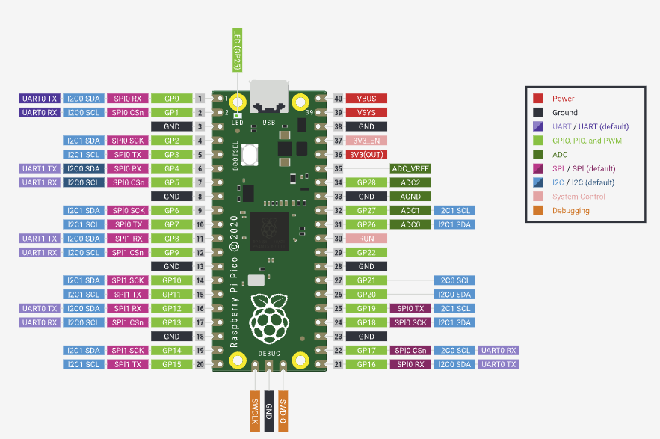
The Pico RP2040 Microcontroller
You have already learnt that LED’s and buttons are controlled using digital output.
However, sometimes you want to be able to obtain information from inputs that has a wider range of values such as the temperature in a fridge or the humidity in a greenhouse
You may also want to control output more precisely such as the speed of a motor the volume of sound
Notes:
The Pico has 3 ADC pins which allows for analogue data to be input via analogue input devices. Digital data has only two states one and off. Analogue data via the Pico has over 65,000 states which allows us to represent or read real life states such as sound.The Pico also has 3 pins that can be used for inputting analogue data
Pins 31, 32 and 34 which are GPIO pins 26, 27 & 28

Slide 5
The Pico and Analogue data
The Pico has 3 special Pins that can be configured to receive analogue data values
These are (ADC) analogue to digital convertor Pins
These are pins 31, 32 and 34 which are GPIO pins 26, 27 & 28
Notes:
The Pico has 3 ADC pins which allows for analogue data to be input via analogue input devices. Digital data has only two states one and off. Analogue data via the Pico has over 65,000 states which allows us to represent or read real life states such as sound.

Slide 6
ADC (Analogue to Digital Convertors
ADCs are like translators that bridge the gap between the analogue world and the digital world of microcontrollers.
ADC’s convert real world values into a digital format understood by digital devices

Slide 7
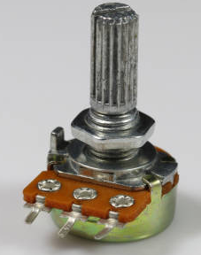
Potentiometers (POTs)
A potentiometer is a three-terminal resistor with a sliding or rotating contact that forms a variable voltage divider.
The resistance of the potentiometer between the rotating contact and terminal is proportional to the distance the dial has moved from that terminal.

Slide 8
Wiring the basic circuit
ADC on Pin 26 or ADC0
Left LEG to 3v
Right Leg to GND
Notes:
ADC 0 and ACD 1 are pin 9th and 10th from the top right hand side

Slide 9
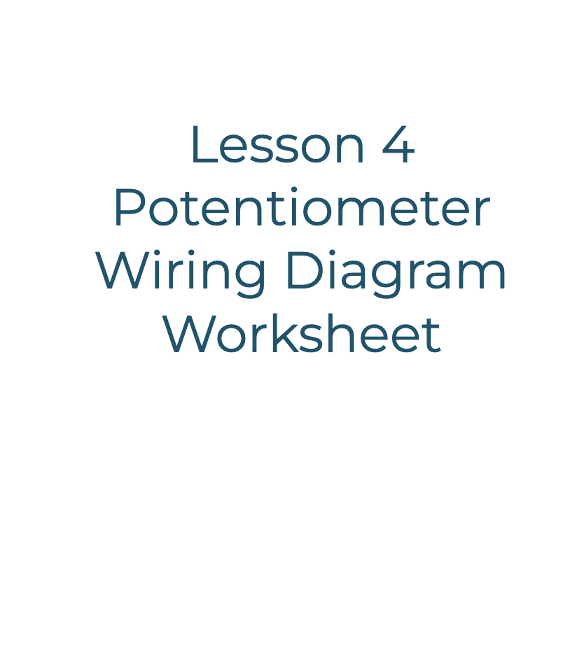
Use the worksheet to create your circuit
Notes:
ADC 0 and ACD 1 are pin 9th and 10th from the top right hand side

Slide 10
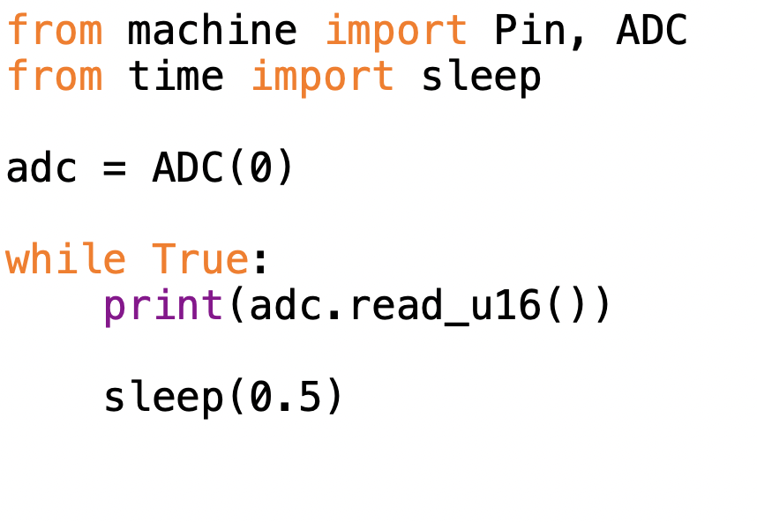
The Starter Code
Notes:
Import Statements
from machine import Pin, ADC
from time import sleep
2. ADC Initialization
adc = ADC(0)
This initialises an ADC object on ADC channel 0. The argument 0 is the ADC pin. note how no GPIO is used here
3. Infinite Loop
while True:
print(adc.read_u16())
sleep(0.5)
while True:
print(adc.read_u16()): Reads the ADC value and prints it.
adc.read_u16(): Reads a 16-bit (unsigned) analogue value from the ADC pin. The u16 means "unsigned 16-bit". The ADC converts the analogue signal into a value ranging from 0 to 65535, corresponding to the voltage level on the pin.
sleep(0.5): Pauses the program for 0.5 seconds before the next iteration of the loop. This adds a delay between consecutive readings, making it easier to observe changes over time.

Slide 11
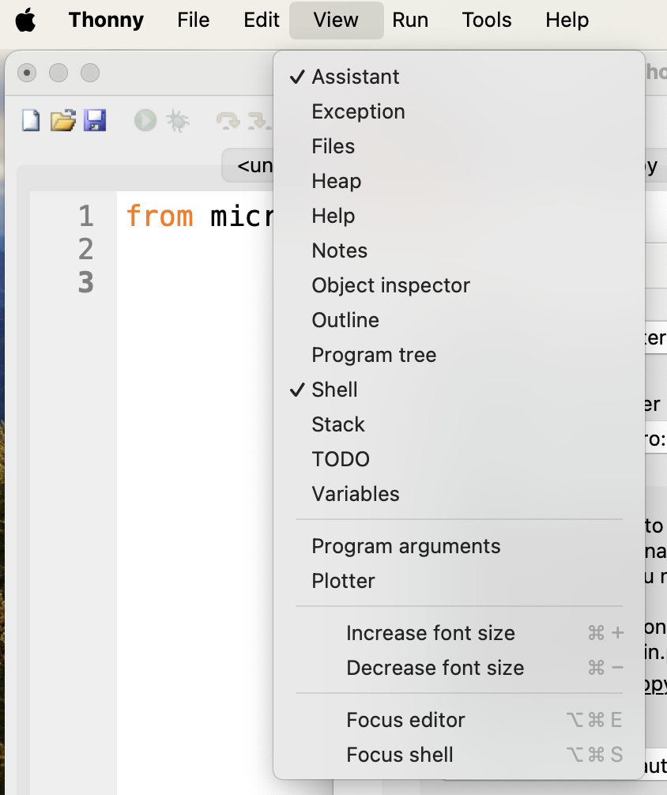
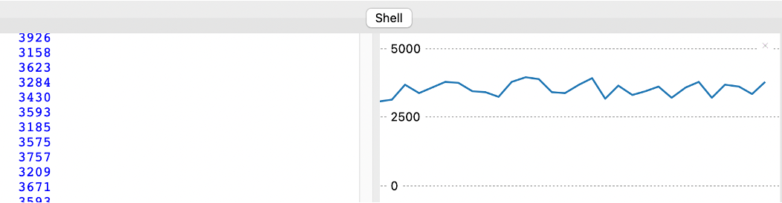
The Plotter
Thonny has a built-in serial plotter that allows you to plot changing analogue data.
Notes:
Demo the starter code and the plotter. The plotter is very useful for debugger any issues with the POT’s

Slide 12
Dimmer Switch
There are many real life applications for potentiometers one of which is a light dimmer switch
To dim an LED we control the voltage using Pulse Width Modulation
PWM turns the digital signal on and off incredibly fast within a given cycle reducing the flow of current and in turn the brightness
Notes:
The brightness of an LED is determined by the current flowing through it. When you apply a PWM signal to an LED, you're controlling the average current flowing through it, which in turn controls the brightness of the light.

Slide 13
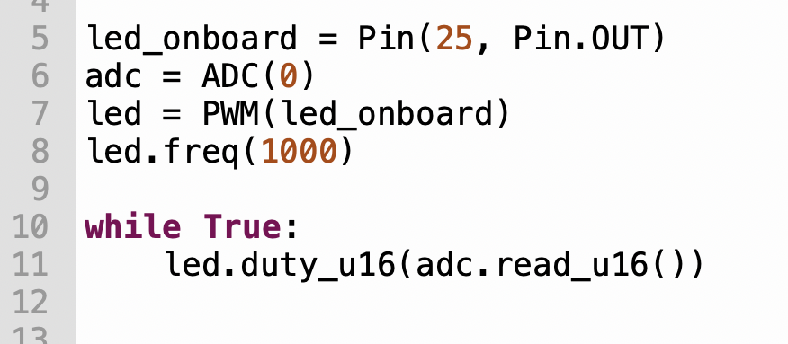
Starter dimmer switch code
Notes:
Note how lines 7 & 8 creates a PWM object and passes in the led_onboard from the earlier activity and sets the frequency the duty cycle is set during the infinite loop to continually adjust the brightness

Slide 14

Use the dimmer switch worksheet to create a dimmer switch

Slide 15
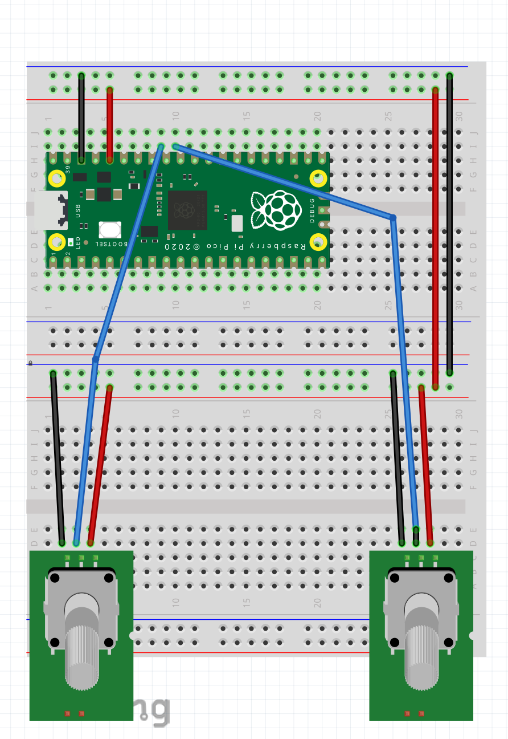
Set up for next lesson
Add a 2nd pot to ADC 1 ready for the next lesson
Notes:
The 2nd challenge students should set up a 2nd POT

Slide 16
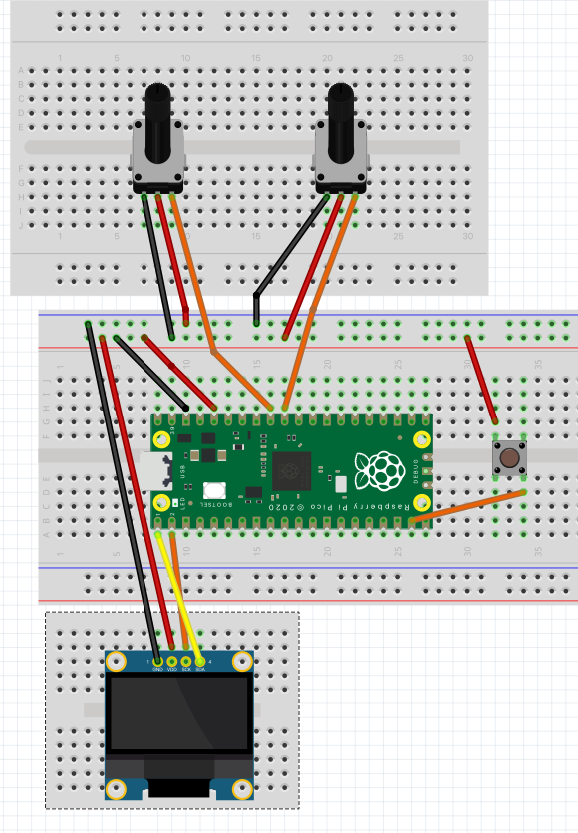
Final Circuit
The final circuit is pretty complex and may look a little different depending on the breadboard set up you are using
What is important are the correct connection between the hardware

Slide 17
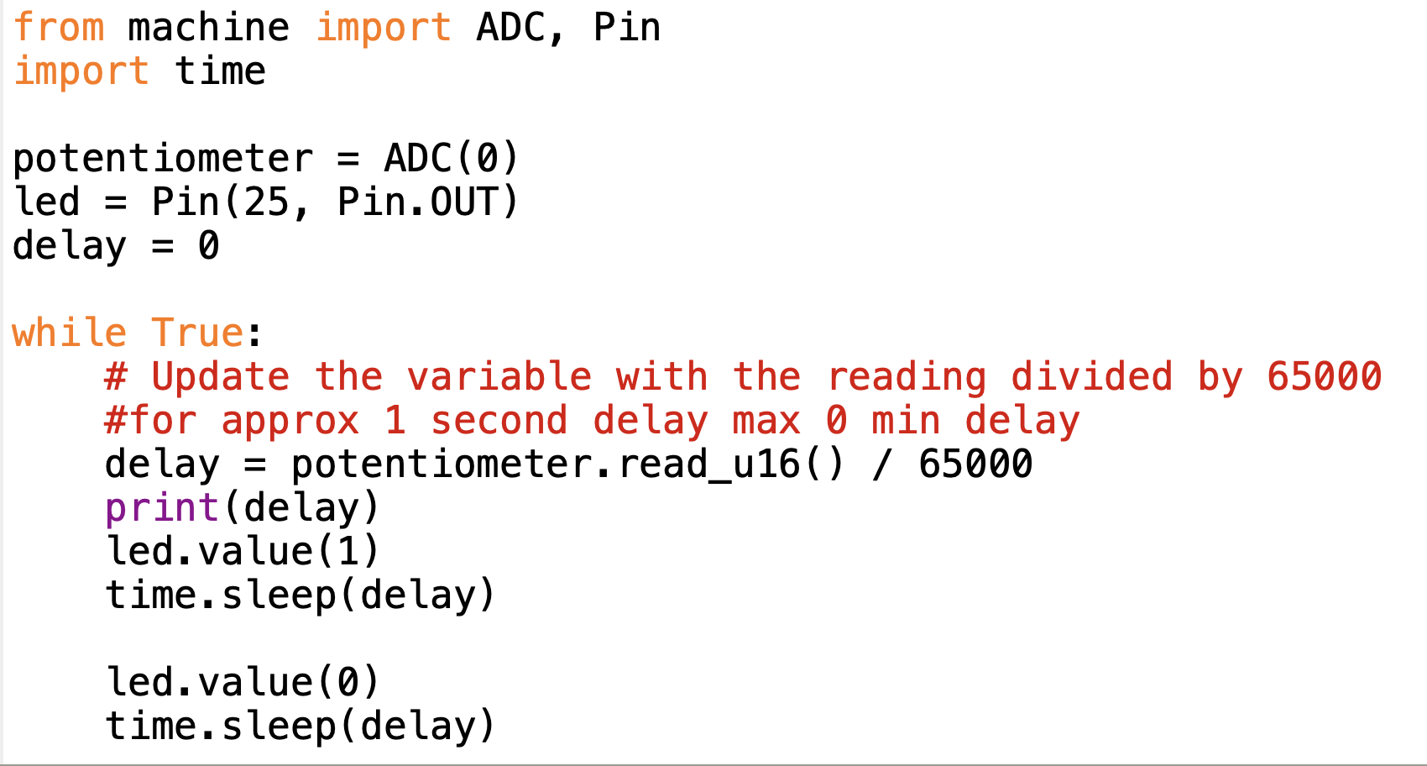
Challenge
Flashing the LED using the pot to reduce/increase the sleep time

Slide 18
Plenary

Slide 19
Explain the purpose of an analogue to digital convertor?
Notes:
To convert real world analogue signals into digital format so that it can be understood by computers

Slide 20
Explain the term PWM?
Notes:
Pulse Width Modulation

Slide 21
Homework
Investigate how analogue to Digital convertors can be used in medicine
Produce an explanation of you findings.
Add appropriate images to support work
Notes:
Pulse Width Modulation

